Slide 1

PERFORMANCE ANALYSIS OF DC FAST CHARGING ARCHITURE OF VEHICLE-TO-GRID TECHNOLOGY IN A MICRO GRID USING PID CONTROLLING TECHNIQUES. PERFORMANCE ANALYSIS OF DC FAST CHARGING ARCHITURE OF VEHICLE-TO-GRID TECHNOLOGY IN A MICRO GRID USING PID CONTROLLING TECHNIQUES.
UNIVERSITY COLLEGE OF ENGINEERING NARASARAOPET
DEPARTMENT OF ELECTRICAL AND ELECTRONICS ENGINNERING
Under the guidance of:
Dr.k.Vimala Kumar
Presented by:
A.Pavan Kumar (19035A0201)
Y.Aravind (18031A0251)
V.Pramod (18031A0249)
V.Karun Kumar (18031A0248)

Slide 2
Contents
Abstract
Block Diagram & description
Battery charger Configuration & its Modes
C - inverter Control
Off Board Charge Control & Micro grid Test System Configuration
Simulation circuits & Its Results
Advantages
Work Status
Conclusion
References

Slide 3
ABSTRACT :
Nowadays the awareness on carbon emission has increased.So the evolution of the Electric vehicles(EV) has started to flourish as EV batteries can be utilised as potential energy storage devices in microgridsElectric Vehicle (EV) batteries can be utilized as potential energy storage devices in micro- grids.
As DC fast charging station with OFF board chargers(i.e, by buck and boost converters) and grid connected inverter is designed to interface EV’s to microgrid.So in this project, the architecture ,high power bi-directional charging for EV’s ,scheduling strategies of Grid to Vehicle(G2V), Vehicle to Grid(V2G) and Battery Energy Storage System (BESS) and their effectiveness is evaluated in MATLAB/SIMULINK.
This charging station design ensures minimal distortion of grid injected current and the controllers according to particular application(pi/pid) gives good dynamic performance in terms of DC bus voltage stability.Thus the microgrid energy management is done by storing energy in EV’s when excess and given back when demand is more and vice versa.

Slide 4
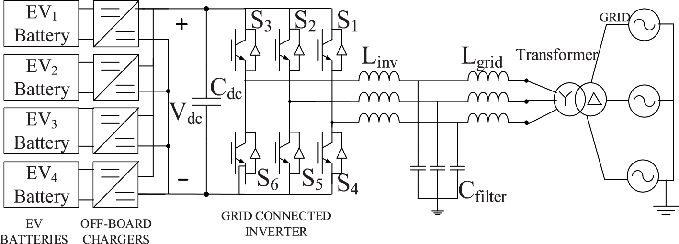
Block Diagram :
Fig. 1. EV charging station for fast dc charging

Slide 5
Battery Charger Configuration
For dc fast charging, the chargers are located off-board and are enclosed in an
EVSE(Electric Vehicle Supply Equipment).
A bidirectional dc-dc converter forms the basic building block of an off-board charger with
V2G capability.
In this there are 2 modes of operations they are : i, Buck Mode of Operation (Charging mode) ii,Boost Mode of Operation (Discharging mode)

Slide 6
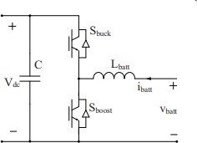
a) Buck Mode of Operation (Charging Mode)
When the upper switch is operating, the converter acts as a buck converter stepping down the input voltage to battery charging voltage.
During the on state, current flows through the switch and inductor to the battery.
This is the charging operation, where the power flow is from the grid to vehicle(g2v).
When the switch is off, the current takes its return path through the inductor and diode of lower switch and completes the circuit.

Slide 7
b) Boost Mode of Operation (Discharging Mode)
When the lower switch is operating, the converter acts as a boost converter stepping up
the battery voltage to the dc bus voltage.
When the switch is in on state, current continues to flow through the inductor and completes its circuit through the anti-parallel diode of the upper switch, and the capacitor.
The net power flow in this case is from the vehicle to the grid (V2G) and the battery operates in the discharge mode.

Slide 8
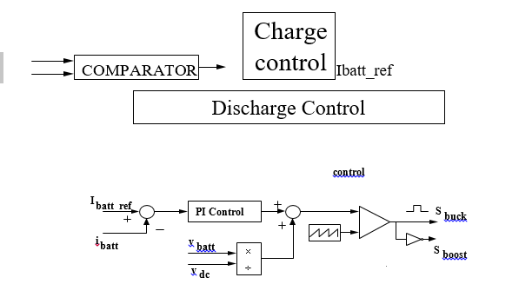
Off-Board Charger Control :
A constant current control strategy using PI controllers is implemented for charge/discharge control of the battery charger circuit and is shown in Fig.3
The controller first compares the reference battery current with zero, in-order to determine the
polarity of the current signal, to decide between charging and discharging modes of operations.

Slide 9
Grid Connected Inverter And LCL Filter
The grid connected inverter (GCI) converts the dc bus voltage into a three phase ac voltage
and also allows the reverse flow of current through the anti-parallel diodes of the switches in each leg.
An LCL filter is connected at the output terminals of the inverter for harmonic reduction and obtaining a pure sinusoidal voltage and current.
The design procedure for determining the LCL filter parameters for this work is adapted.

Slide 10
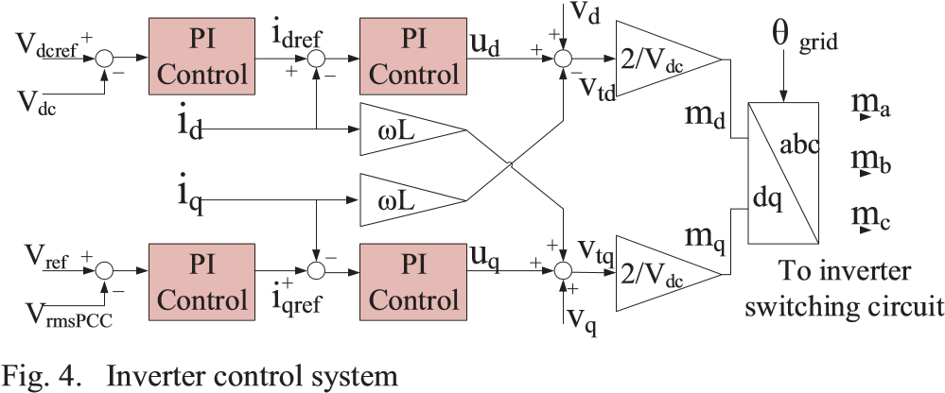
C. Inverter control :
A cascade control in synchronous reference frame is proposed for the inverter controller.
The conventional standard vector control using 4 PI controllers in a nested loop.
The control structure consists of two outer voltage control loops and two inner current control
loops.
The d-axis outer loop controls the dc bus voltage and
inner loop controls the active ac current
Also, dc decoupling terms L and feed-forward voltage signals are added to improve the
performance during transients.

Slide 11
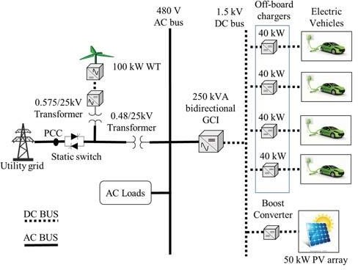
Micro Grid Test system configuration :
The EV battery storage system consists of 4 EV batteries connected to a 1.5 kV dc bus of the
charging station through off-board chargers.
The solar PV is also connected to this dc bus through a boost converter which has a maximum
power point tracking (MPPT) controller.
The utility grid consists of a 25 kV distribution feeder and a 120 kV equivalent transmission
system.

Slide 12
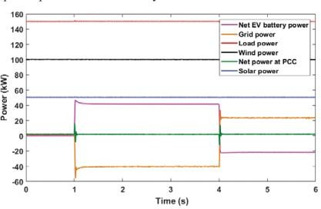
Active Power Profile
The active power contribution from various components of the system is shown in below diagram.
The grid power changes to accommodate the power transferred by the EVs.
The negative polarity of the grid power from 1s to 4s shows that the power is being fed to the grid from the vehicle.
The change in polarity of grid power at 4s shows that the power is supplied by the grid for
charging the vehicle battery.

Slide 13
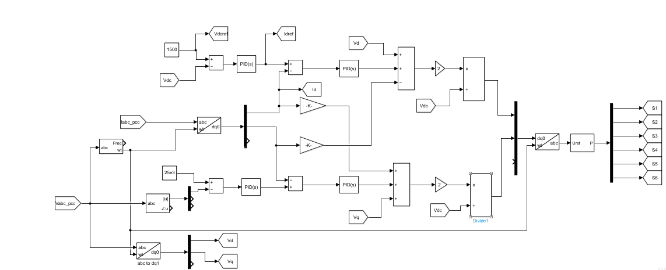
Sub System(Inverter Control)

Slide 14
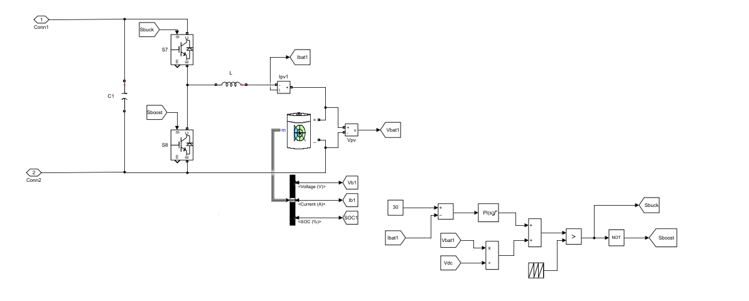
Sub System(Off Board Charger)

Slide 15
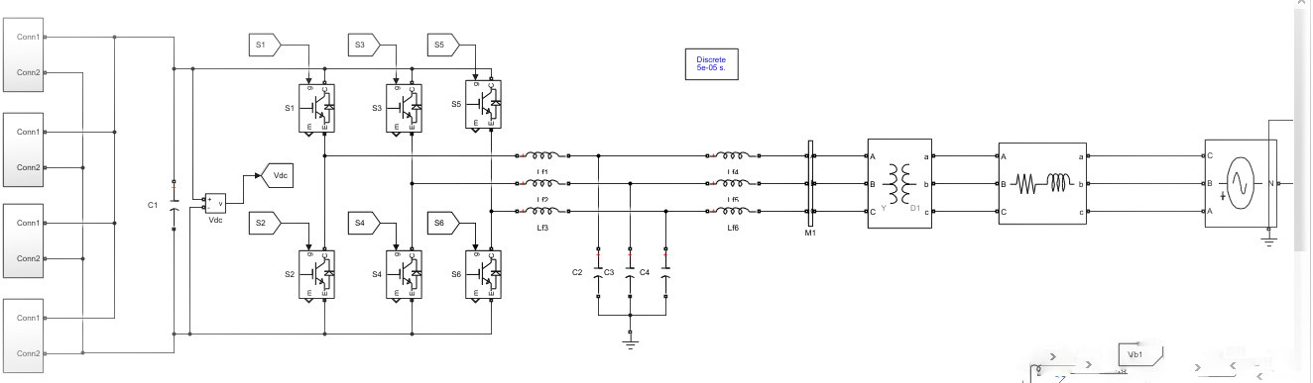
Simulation Circuit

Slide 16
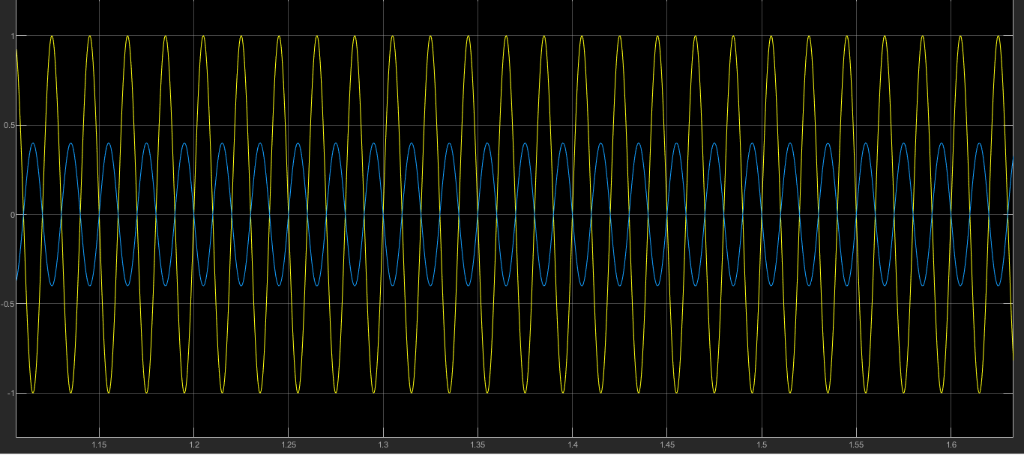
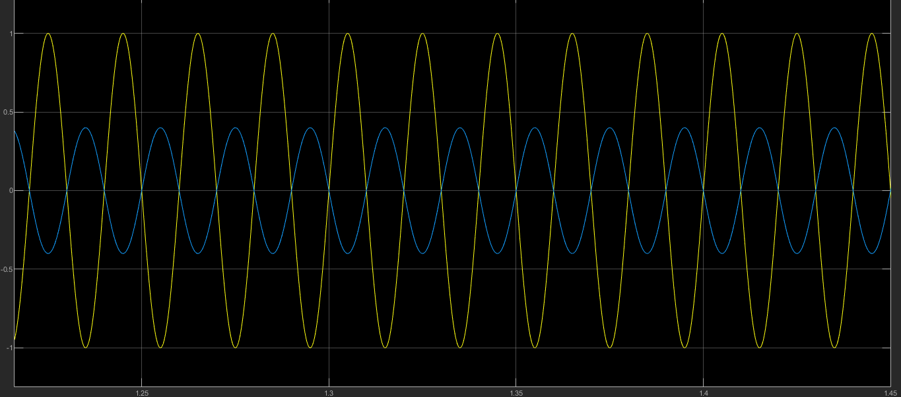
SIMULATION RESULTS :

Slide 17
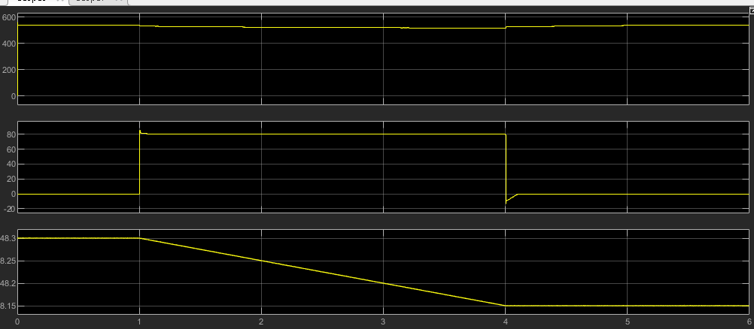
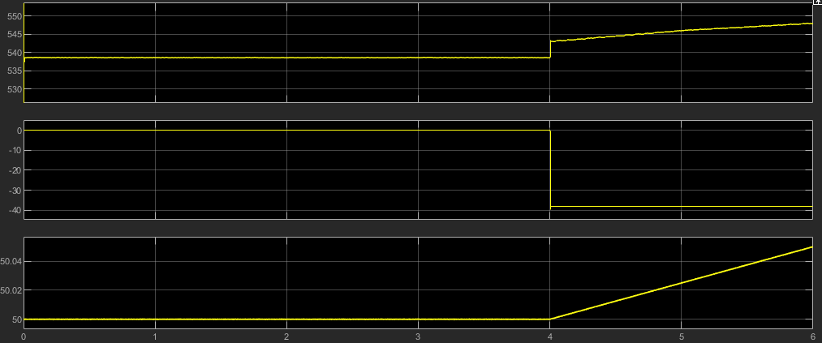
.

Slide 18
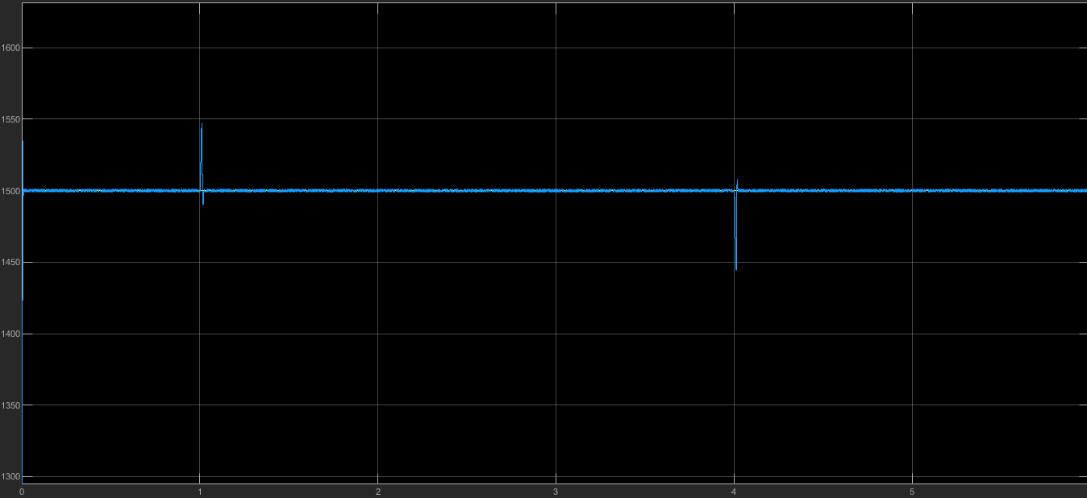

Slide 19
Advantages/Disadvantages
Network operators can optimize investments & stabilize the grid
Increases reliability and efficiency of the power system.
Vehicle can provide extra power during demand peaks.
Grid allocation (Automatic generation control AGC)

Slide 20
Conclusion :
Modeling and design of a V2G system in a micro-grid using dc fast charging architecture
is presented in this paper.
A dc fast charging station with off-board chargers and a grid connected inverter is designed to interface EVs to the micro- grid.
The simulation results show a smooth power transfer between the EVs and the grid, and the quality of grid injected current from the EVs adheres to the relevant standards.

Slide 21
References :
A. Negi and M. Mathew, "Study on Sustainable Transportation Fuels Based on Green House Gas Emission Potential," in International Conference on Power Energy, Environment and Intelligent Control (PEEIC), Greater Noida, India, 2018.
D. Kurczynski, P. Lagowski and M. Warianek, "The impact of natural gas on the ecological safety of using Diesel engine," in XI International 4102 Science-Technical Conference
Automotive Safety, Casta, Slovakia , 2018.
S. Majumder, K. De and P. Kumar, "Zero emission transportation system," in International
Conference on Power Electronics, Drives and Energy Systems (PEDES), Trivandrum,
India, 2016.
X. Lu, K. Ota, M. Dong, C. Yu and H. Jin, "Predicting Transportation Carbon Emission
with Urban Big Data," Trans on Sustainable Computing, vol. 2, no. 4, pp. 333-344, 2017.
Xiong R. et al, "Lithium-Ion Battery Health Prognosis Based on a Real Battery
Management System Used in Electric Vehicles," Trans on Vehicular Technology, vol. 68,
no. 5, pp. 4110-4121, 2019.

